Slide 1


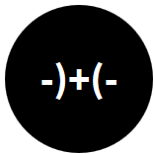
Opening the Black Box of Interaction in Visualization
Hans-Jörg Schulz¹, Tatiana v. Landesberger², Dominikus Baur³
VIS Tutorial 2014
D .MINIK.US
Fraunhofer IGD, Rostock, Germany
TU Darmstadt, Darmstadt, Germany
Dominikus Baur Interfacery

Slide 2
INTRODUCTION

Slide 3

About the Speakers: Hans-Jörg Schulz
PhD in 2010 @ University of Rostock
Thesis on Graph Visualization
Currently Senior Researcher @ Competence Center Interactive Document Engineering, Fraunhofer Inst. for Computer Graphics Research, Rostock
Fields of Research:
Design Spaces
Vis. of Heterogeneous Data
Vis. for the Life Sciences
Graph & Tree Visualization

Slide 4
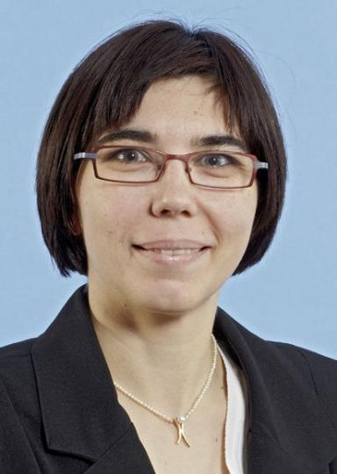
About the Speakers: Tatiana von Landesberger
PhD in 2010 @ TU Darmstadt
Thesis on Visual Analytics of graphs and time-dependent data
Now head of the Visual Analysis and Search Group @ TU Darmstadt
Fields of Research:
Visual analysis of graphs
Visual analysis of time-dependent data
Visual cluster analysis
Application areas: finance, biology and meteorology

Slide 5

About the Speakers: Dominikus Baur
PhD in 2011 @ LMU Munich
Thesis on Visualizing music listening histories
Now independent researcher
Fields of Research:
Data Visualization
Mobile Interaction Design
…

Slide 6
About the Tutorial Topic
The History of Human-Computer-Interaction
Image taken from Saffer (2010)
The Status Quo before Interaction Design
Notes:
Jacob Moreno

Slide 7
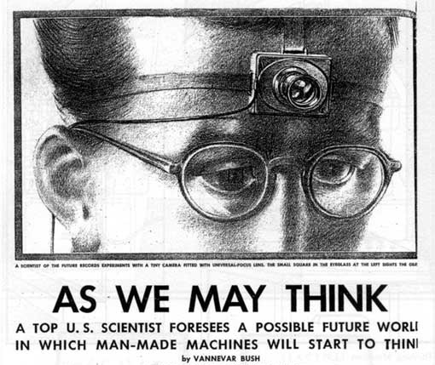
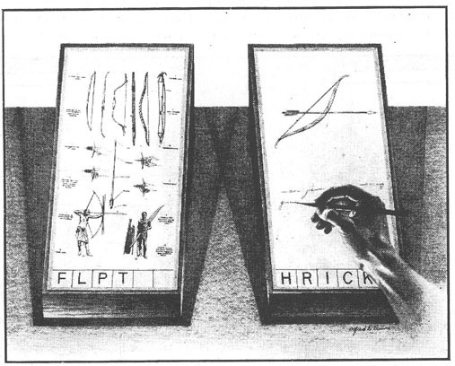
About the Tutorial Topic
The History of Human-Computer-Interaction
1945 – Vannevar Bush: Article in Atlantic Monthly on “Memex” (written in 1936!)
Notes:
Jacob Moreno

Slide 8
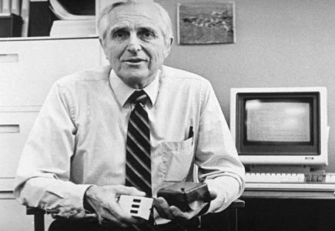
About the Tutorial Topic
The History of Human-Computer-Interaction
1963 – Ivan Sutherland: Sketchpad
1968 – Doug Engelbart: First presentation of the mouse (among other things)
Notes:
Jacob Moreno

Slide 9
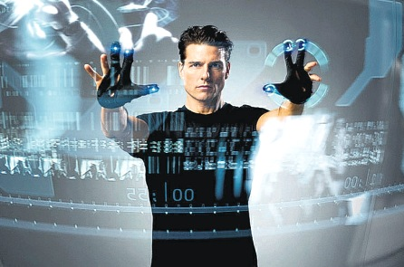
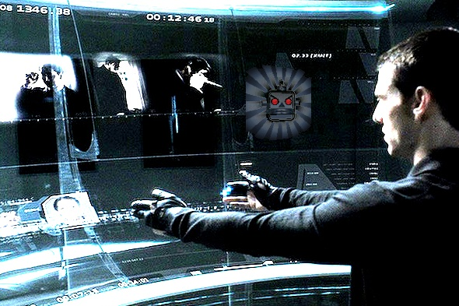
About the Tutorial Topic
The History of Human-Computer-Interaction
2002 – Minority Report featuring Multitouch and Gesture-based Interaction
Notes:
Jacob Moreno

Slide 10
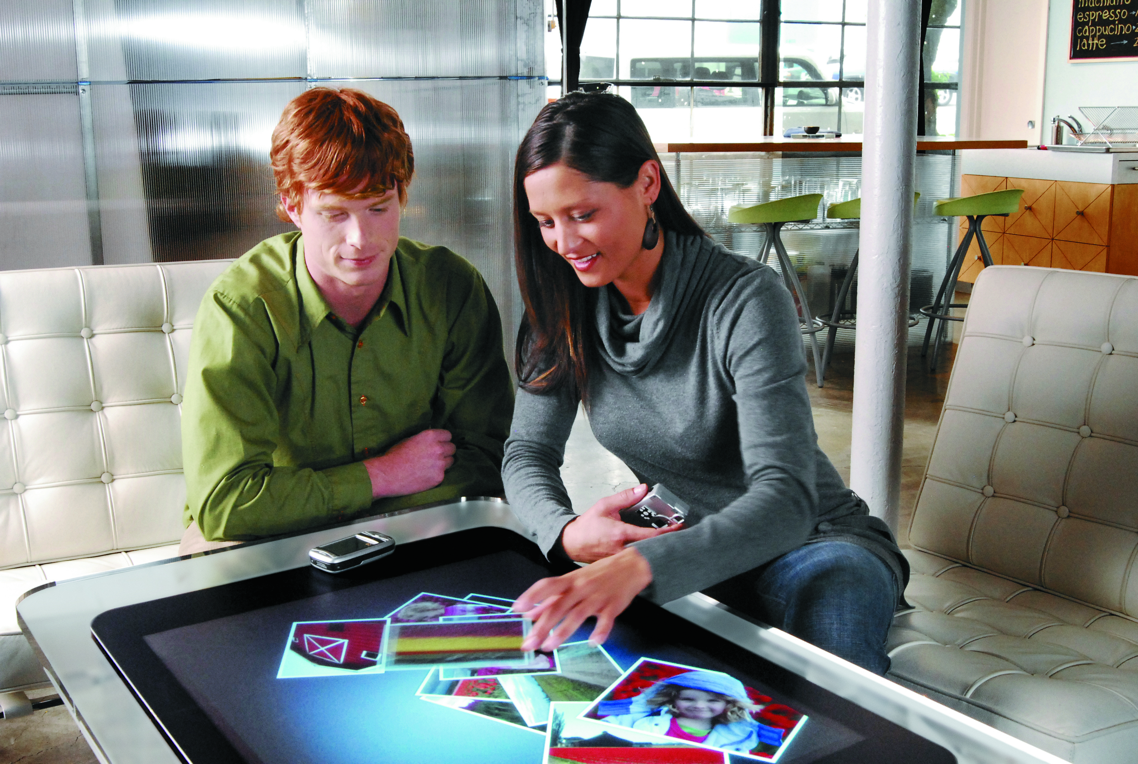
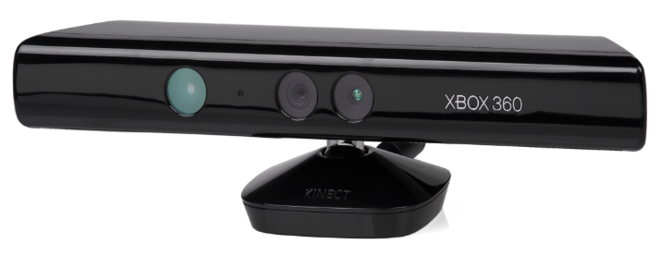
About the Tutorial Topic
The History of Human-Computer-Interaction
2007 – MS Surface
2009 – MS Kinect
Notes:
Jacob Moreno

Slide 11
What‘s YOUR BACKGROUND?
Field: Academia, Industry, Arts,…
Flavor: UX, UI, Interaction Design, Vis Design,…
Level: Master, PhD, PostDoc, Professor,…

Slide 12
Interaction can take many forms
Image taken from Spindler et al. (2010)
Image taken from Waldner et al. (2009)
Image taken from Jackson et al. (2013)

Slide 13
…which makes it hard to define
“HCI research is far from having solid (and falsifiable) theories of interaction.”
̶ Beaudouin-Lafon 2004
Interaction = direction manipulation and instantaneous change
Selection taken from Yi et al. (2007)
̶ Becker, Cleveland, Wilks 1987
Interaction = communication between user and the system
̶ Dix, Finlay, Abowd, Beale 2004

Slide 14
Defining Interaction as a form of Communication
NOISE
CHANNEL
SENDER
SIGNAL
RECEIVER
The common communication model (simplified)
ALPHABET

Slide 15
Defining Interaction as a form of Communication
Note: There can be multiple instances of each component
NOISEs
CHANNELs
SENDERs
SIGNALs
RECEIVERs
WORD
…
ALPHABETs
…

Slide 16
Defining Interaction as a form of Communication
NOISE
CHANNEL
SIGNAL
SENDER
RECEIVER
SIGNAL
(BACK)CHANNEL
ALPHABET

Slide 17
Defining Interaction as a form of Communication
NOISE

CHANNEL

SIGNAL
SIGNAL
(BACK)CHANNEL
ALPHABET

Slide 18
Defining Interaction as a form of Communication
NOISE

CHANNEL

INPUT
OUTPUT
(BACK)CHANNEL
ALPHABET

Slide 19
Defining Interaction as a form of Communication
NOISE

INPUT DEVICE / UI

INPUT
OUTPUT
VISUALIZATION
ALPHABET

Slide 20
Defining Interaction as a form of Communication
NOISE

INPUT DEVICE / UI

INPUT
OUTPUT
VISUALIZATION
INTERACTION VOCABULARY
VISUAL VOCABULARY

Slide 21
Defining Interaction as a form of Communication
INTERFERENCE

INPUT DEVICE / UI

INPUT
OUTPUT
VISUALIZATION
INTERACTION VOCABULARY
VISUAL VOCABULARY

Slide 22
Why do we need interaction?
“A graphic is not drawn once and for all; it is constructed and reconstructed until it reveals all the relationships constituted by the interplay of the data.” -- J. Bertin, 1981
“Visual representations alone cannot satisfy analytical needs. Interaction techniques are required to support the dialogue between the analyst and the data.” -- Thomas & Cook, 2005

Slide 23
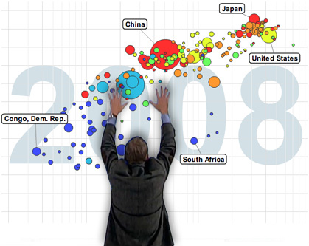

Why do we need interaction?
Interaction techniques allow us to
to query the data (directed search)
to explore the data (undirected search)
to work around problems of the visualization (occlusion,…)
Image taken from http://gapminder.org

Slide 24

About the Tutorial Topic




Activities: What the user does to trigger a change in the computer (Action)
Metaphor: What the user thinks the computer is doing and vice versa (Understanding)
Architecture: What the computer actually does (Reaction)
Notes:
Jacob Moreno

Slide 25
About the Tutorial Structure
Tentative Schedule:
0. Introduction (you’re listening to it right now) 14:00-14:10 (≈ 10minutes)
Interaction Activities 14:10-15:10 (≈ 60 minutes)
Interaction Architecture 15:10-15:40 (≈ 30 minutes) 15:40-16:10 coffee break 16:10-16:40 (≈ 30 minutes)
Interaction Metaphors and Guidelines 16:40-17:40 (≈ 60 minutes)
Summary and Q&A 17:40-17:55 (≈ 15 minutes)

Slide 26
About the Tutorial Structure
If you have remarks or questions please feel free to ask them on the spot!
Download this Slide Deck + the Literature List @
http://tinyurl.com/tutorial2014

